Slide 1


Introduction to Data Mining Chapter 1 Introduction
by Michael Hahsler
Based on slides by Tan, Steinbach, Karpatne, Kumar
This work is licensed under a Creative Commons Attribution-ShareAlike 4.0 International License.

Slide 2
Agenda
What is Data Mining?
Data Mining Tasks
Relationship to Statistics, Optimization, Machine Learning and AI
Tools
Data
Legal, Privacy and Security Issues

Slide 3
What is Data Mining?
One of many definitions:
"Data mining is the science of extracting useful knowledge from huge data repositories."
ACM SIGKDD, Data Mining Curriculum: A Proposal
http://www.kdd.org/curriculum

Slide 4






Why Data Mining? Commercial Viewpoint
Businesses collect and warehouse lots of data.
Purchases at department/grocery stores
Bank/credit card transactions
Web and social media data
Mobile and IOT
Computers are cheaper and more powerful.
Competition to provide better services.
Mass customization and recommendation systems
Targeted advertising
Improved logistics
Notes:
4

Slide 5
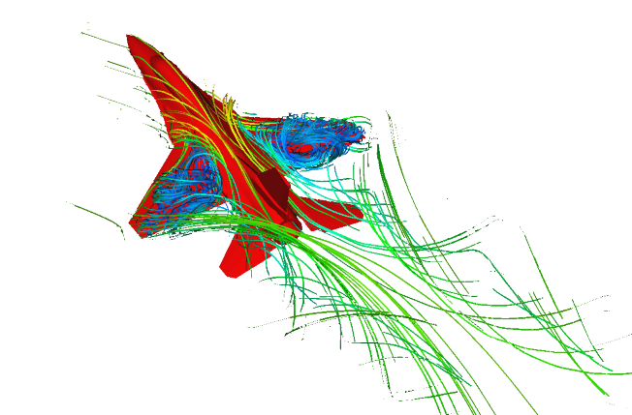

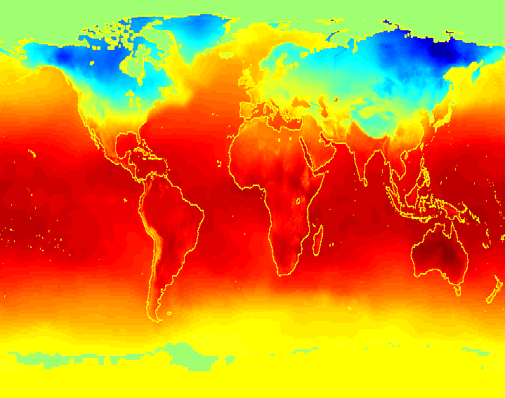
Why Mine Data? Scientific Viewpoint
Data collected and stored at enormous speeds (GB/hour)
remote sensors on a satellite
telescopes scanning the skies
microarrays generating gene expression data
scientific simulations generating terabytes of data
Data mining may help scientists
identify patterns and relationships
to classify and segment data
formulate hypotheses

Slide 6
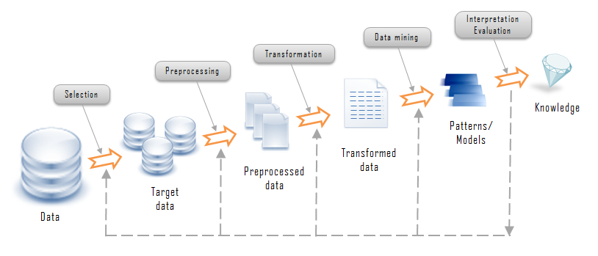
Knowledge Discovery in Databases (KDD) Process
Data normalization
Noise/outliers
Missing data
Decide on task & algorithm
Performance?
Data/dim. reduction
Features engineering
Feature selection
Understand domain
Usama M. Fayyad, Gregory Piatetsky-Shapiro, and Padhraic Smyth. 1996. From data mining to knowledge discovery: an overview.

Slide 7
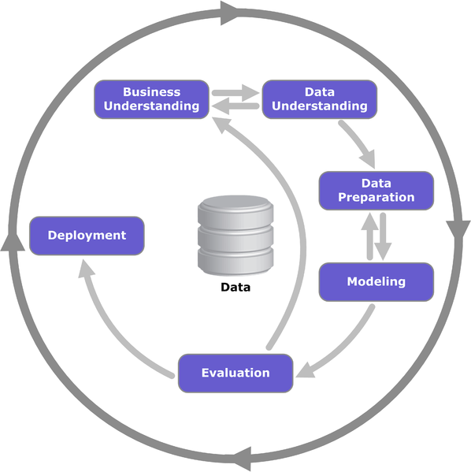
CRISP-DM Reference Model
Cross Industry Standard Process for Data Mining
Open standard process model
Industry, tool and application neutral
Defines tasks and outputs.
Now developed by IBM as the Analytics Solutions Unified Method for Data Mining/Predictive Analytics (ASUM-DM).
SAS has SEMMA and most consulting companies use their own similar process.
https://en.wikipedia.org/wiki/Cross_Industry_Standard_Process_for_Data_Mining

Slide 8
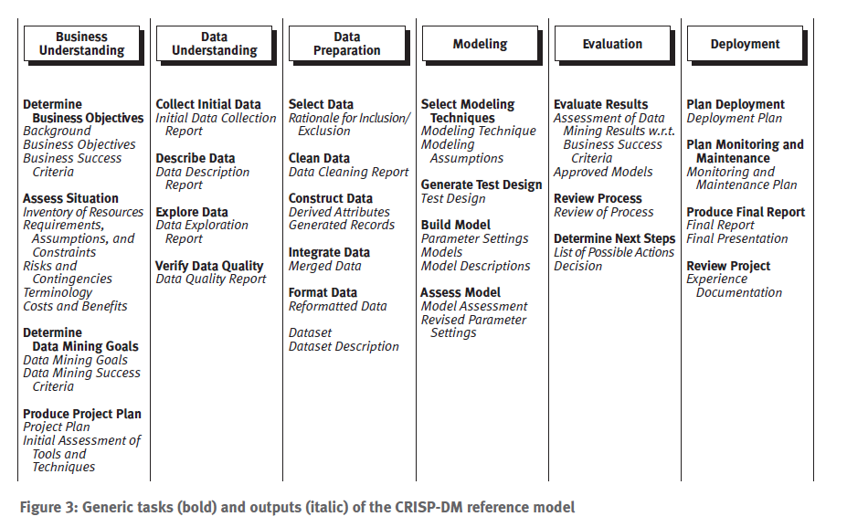
Tasks in the CRISP-DM Model

Slide 9
Agenda
What is Data Mining?
Data Mining Tasks
Relationship to Statistics, Optimization, Machine Learning and AI
Tools
Data
Legal, Privacy and Security Issues

Slide 10
Data Mining Tasks
Data Exploration: Find human-interpretable patterns that describe the data. Visualize patterns.
Predictive Methods
Modeling: Use some features (variables) to predict unknown or future value of other variable.
Descriptive Methods
Data Preparation
Data Wrangling: Data acquisition, understanding, cleaning, and preprocessing.

Slide 11
Data Mining Methods
Predictive Models
+
+
+
+
+
+
+
+
+
+
+
+
Descriptive Models
(Data Exploration)
+
+
Regression
Classification
Introduction to Data Mining by Pang-Ning Tan, Michael Steinbach and Vipin Kumar, Addison Wesley, 2006

Slide 12
Data Mining Methods
+
+
+
+
+
+
+
+
+
+
+
+
+
+
Regression
Classification

Slide 13
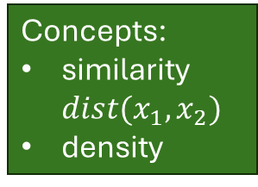
Clustering
Group points such that
Data points in one cluster are more similar to one another.
Data points in separate clusters are less similar to one another.
Ideal grouping is not known → Unsupervised Learning
Intracluster distances
are minimized
Intercluster distances
are maximized
Concepts:
similarity$dist(x_{1},x_{2})$
density
Euclidean distance based clustering in 3-D space.

Slide 14

Clustering: Market Segmentation
Goal: subdivide a market into distinct subsets of customers. Use a different marketing mix for each segment.
Approach:
1. Collect different attributes of customers based on their geographical and lifestyle related information and observed buying patterns.
2. Find clusters of similar customers.

Slide 15

Clustering Documents
Goal: Find groups of documents that are similar to each.
Approach: Identify frequently occurring terms in each document. Define a similarity measure based on term co-occurrences. Use it to cluster.
Gain: Can be used to organize documents or to create recommendations.

Slide 16

Clustering: Data Reduction
Goal: Reduce the data size for predictive models.
Approach: Group data given a subset of the available information and then use the group label instead of the original data as input for predictive models.

Slide 17
Data Mining Methods
+
+
+
+
+
+
+
+
+
+
+
+
+
+
Regression
Classification

Slide 18
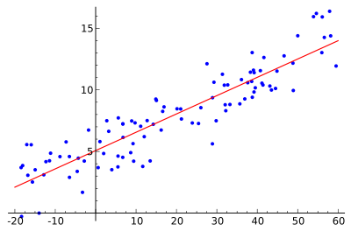
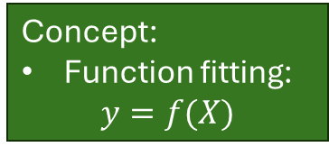
Regression
Concept:
Function fitting: $y=f(X)$
Predict a value of a given continuous valued variable based on the values of other variables, assuming a linear or nonlinear model of dependency.
Studied in statistics and econometrics.
Applications:
Predicting sales amounts of new product based on advertising expenditure.
Predicting wind velocities as a function of temperature, humidity, air pressure, etc.
Time series prediction of stock market indices (autoregressive models).

Slide 19
Data Mining Methods
+
+
+
+
+
+
+
+
+
+
+
+
+
+
Regression
Classification

Slide 20
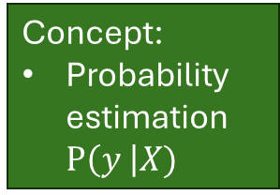
Classification
Find a model for the class attribute as a function of the values of other attributes/features.
Class information is available → Supervised Learning
class
Concept:
Probability estimation $P\left(y \right|X)$
Learn
Classifier
Training
Set
Model

Slide 21
Classification
Find a model for the class attribute as a function of the values of other attributes/features.
Goal: assign new records to a class as accurately as possible.
class
Test Set
Learn
Classifier
Training
Set
Model

Slide 22

Classification: Direct Marketing
Goal: Reduce cost of mailing by targeting a set of consumers likely to buy a new product.
Approach:
Use the data for a similar product introduced before or from a focus group. We have customer information (e.g., demographics, lifestyle, previous purchases) and know which customers decided to buy and which decided otherwise. This buy/don’t buy decision forms the class attribute.
Use this information as input attributes to learn a classifier model.
Apply the model to new customers to predict if they will buy the product.

Slide 23

Classification: Customer Attrition/Churn
Goal: To predict whether a customer is likely to be lost to a competitor.
Approach:
Use detailed record of transactions with each of the past and present customers, to find attributes (frequency, recency, complaints, demographics, etc.).
Label the customers as loyal or disloyal.
Find a model for disloyalty.
Rank each customer on a loyal/disloyal scale (e.g., churn probability).

Slide 24

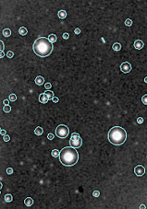
Classification: Sky Survey Cataloging
Goal: To predict class (star or galaxy) of sky objects, especially visually faint ones, based on the telescopic survey images (from Palomar Observatory).
Approach:
Segment the image to identify objects.
Derive features per object (40).
Use known objects to model the class based on these features.
Result: Found 16 new high red-shift quasars.
From [Fayyad, et.al.] Advances in Knowledge Discovery and Data Mining, 1996

Slide 25
Data Mining Methods
+
+
+
+
+
+
+
+
+
+
+
+
+
+
Regression
Classification

Slide 26

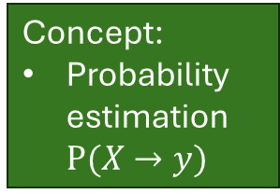
Association Rule Discovery
Given is a set of transactions. Each contains a number of items.
Produce dependency rules of the form LHS → RHS
which indicate that if the set of items in the LHS are in a transaction, then the transaction likely will also contain the RHS item.
TID | Items
1 | Bread, Coke, Milk
2 | Beer, Bread
3 | Beer, Coke, Diaper, Milk
4 | Beer, Bread, Diaper, Milk
5 | Coke, Diaper, Milk
Discovered Rules
{Milk} → {Coke}
{Diaper, Milk} → {Beer}
Concept:
Probability estimation $P(X→y)$
Transaction data

Slide 27
Association Rule Discovery Marketing and Sales Promotion
Let the rule discovered be {Potato Chips, … } → {Soft drink}
Soft drink as RHS: What should be done to boost sales? Discount Potato Chips?
Potato Chips in LHS: Shows which products would be affected if the store discontinues selling Potato Chips.
Potato Chips in LHS and Soft drink in RHS: What products should be sold with Potato Chips to promote sales of Soft drinks!

Slide 28

Association Rule Discovery Supermarket shelf management
Goal: To identify items that are bought together by sufficiently many customers.
Approach:
Process the point-of-sale data to find dependencies among items.
Place dependent items
close to each other (convenience).
far from each other to expose the customer to the maximum number of products in the store.

Slide 29

Association Rule Discovery Inventory Management
Goal: Anticipate the nature of repairs to keep the service vehicles equipped with right parts to speed up repair time.
Approach: Process the data on tools and parts required in previous repairs at different consumer locations and discover co-occurrence patterns.

Slide 30
Data Mining Methods
+
+
+
+
+
+
+
+
+
+
+
+
+
+
Regression
Classification

Slide 31
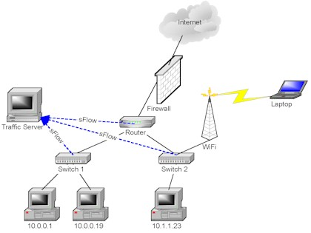
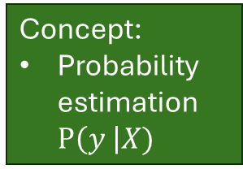
Deviation/Anomaly Detection
Concept:
Probability estimation $P\left(y \right|X)$
Detect significant deviations from normal behavior.
Applications:
Credit Card Fraud Detection
Network Intrusion Detection
Typical network traffic at University
level may reach over 100 million connections per day

Slide 32
Other Data Mining Tasks
Text mining – document clustering, topic models
Graph mining – social networks
Data stream mining/real time data mining
Mining spatiotemporal data (e.g., moving objects)
Visual data mining
Distributed data mining

Slide 33
Challenges of Data Mining
Scalability
Dimensionality
Complexity and heterogeneous data
Data quality
Data ownership and privacy

Slide 34

Agenda
What is Data Mining?
Data Mining Tasks
Relationship to Statistics, Optimization, Machine Learning and AI
Tools
Data
Legal, Privacy and Security Issues

Slide 35
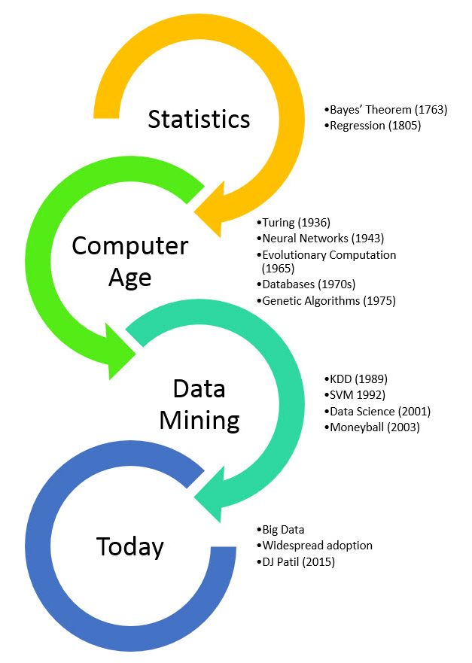
Origins of Data Mining
Draws ideas from AI, machine learning, pattern recognition, statistics, and database systems.
There are differences in terms of
used data and
the goals.
AI
Machine Learning (1959-)
Generative AI (2024)
https://rayli.net/blog/data/history-of-data-mining/

Slide 36
Relationship to other Fields
Field
Data Science?
Big Data?
Learning Strategy
Artificial
Intelligence
Analytics?
Supervised
Learning
Machine
Learning
Unsupervised
Learning
Optimization
Statistical
Learning
Data
Mining
Reinforcement
Learning
Statistics
Online
Learning
+ Application Areas
Math

Slide 37
Relationship to other Fields
Field
Learning Strategy
Artificial
Intelligence
Supervised
Learning
Machine
Learning
Unsupervised
Learning
Optimization
Statistical
Learning
Data
Mining
Reinforcement
Learning
Statistics
Online
Learning
Artificial Intelligence: Create an autonomous agent that perceives its environment and takes actions that maximize its chance of reaching some goal. Areas: reasoning, knowledge representation, planning, learning, natural language processing, and vision.

Slide 38
Relationship to other Fields
Field
Learning Strategy
Artificial
Intelligence
Supervised
Learning
Machine
Learning
Unsupervised
Learning
Optimization
Statistical
Learning
Data
Mining
Reinforcement
Learning
Statistics
Online
Learning
Optimization: Selection of a best alternative from some set of available alternatives using an objective criterion.
Techniques: Linear programming, integer programming, nonlinear programming, stochastic and robust optimization, heuristics, etc.

Slide 39
Relationship to other Fields
Field
Learning Strategy
Artificial
Intelligence
Supervised
Learning
Machine
Learning
Unsupervised
Learning
Optimization
Statistical
Learning
Data
Mining
Reinforcement
Learning
Statistics
Online
Learning
Statistics: Study of the collection, analysis, interpretation, presentation, and organization of data.
Techniques: Descriptive statistics, statistical inference (estimation, testing), design of experiments.

Slide 40
Relationship to other Fields
Field
Learning Strategy
Artificial
Intelligence
Supervised
Learning
Machine
Learning
Unsupervised
Learning
Optimization
Statistical
Learning
Data
Mining
Reinforcement
Learning
Statistics
Online
Learning
Learning Strategy: From what data do we learn?
Is a training set with correct answers available? → Supervised learning
Long-term structure of rewards? → Reinforcement learning
No answer and no reward structure available? → Unsupervised learning
Do we have to update the model regularly? → Online learning

Slide 41
Relationship to other Fields
Field
Learning Strategy
Artificial
Intelligence
Supervised
Learning
Machine
Learning
Unsupervised
Learning
Optimization
Statistical
Learning
Data
Mining
Reinforcement
Learning
Statistics
Online
Learning
Statistical learning: deals with the problem of finding a predictive function based on data.
Techniques: (Linear) classifiers, regression and regularization.

Slide 42
Relationship to other Fields
Field
Learning Strategy
Artificial
Intelligence
Supervised
Learning
Machine
Learning
Unsupervised
Learning
Optimization
Statistical
Learning
Data
Mining
Reinforcement
Learning
Statistics
Online
Learning
Machine Learning create algorithms that can learn from data and generalize to unseen data to perform a task without explicit instructions.
Techniques: Focus on supervised learning (e.g., classification).

Slide 43
Relationship to other Fields
Field
Learning Strategy
Artificial
Intelligence
Supervised
Learning
Machine
Learning
Unsupervised
Learning
Optimization
Statistical
Learning
Data
Mining
Reinforcement
Learning
Statistics
Online
Learning
Data Mining: Analyze a given dataset to gain insights (knowledge) that can be used to improve outcomes.
Techniques: Any applicable technique from databases, statistics, machine/statistical learning. New methods were developed by the data mining community.

Slide 44
Analytics, Data Science and Big Data
Field
Data Science?
Big Data?
Learning Strategy
Artificial
Intelligence
Analytics?
Supervised
Learning
Machine
Learning
Unsupervised
Learning
Optimization
Statistical
Learning
Data
Mining
Reinforcement
Learning
Statistics
Online
Learning
+ Application Areas
Math

Slide 45
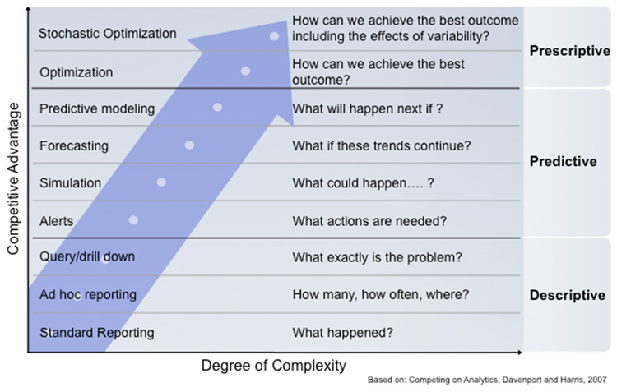
Analytics covers Data Mining
OR
Data Mining
Statistics /
Machine Learning
Operations
Research (OR)
DB / CS

Slide 46
The Prescriptive Analytics Approach
What decisions should we make now to achieve the best future outcome?
This is also the objective of Data Mining.
Data
Predictive
Model
Predict what
will happen
in the future
Decision
Predict what
will change
Evaluate
predicted
outcomes
Predict what
will happen
Optimize
Issues:
What are the decision variables? Causality?
Relationship can be non-linear. Convex? Optimization may be challenging.
Uncertainty about quality and reliability of the predictive model.

Slide 47
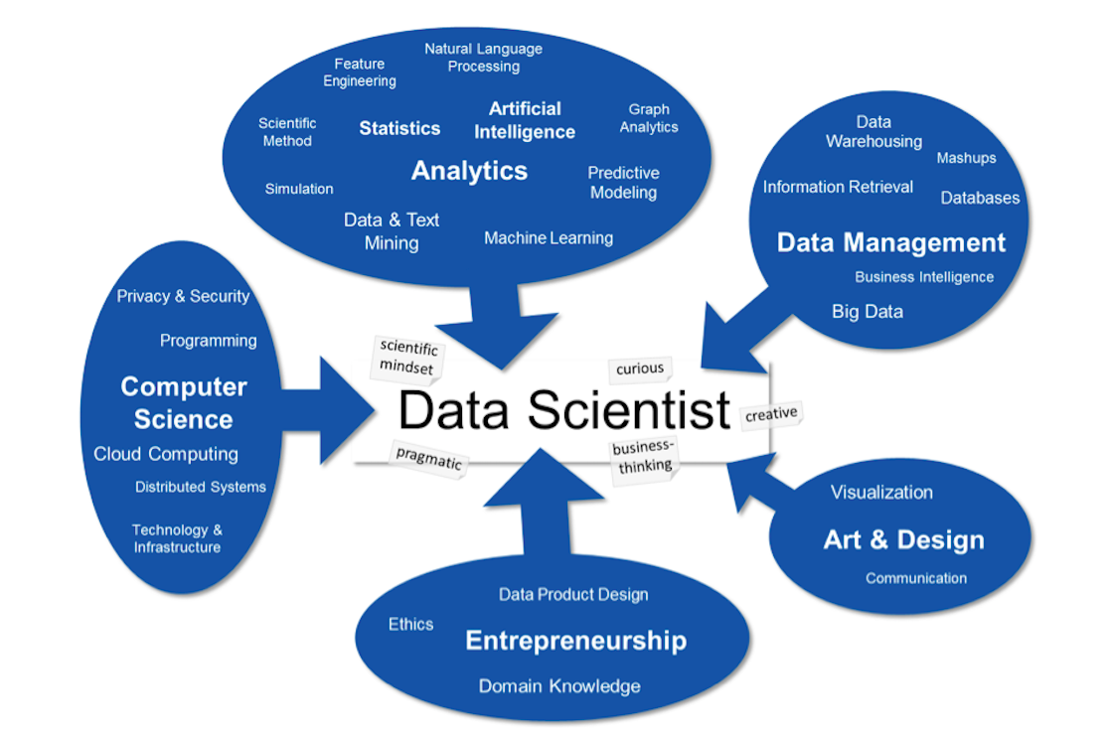
A Data Scientist does Analytics
Source: T. Stadelmann, et al., Applied Data Science in Europe
Good luck finding this person! Probably a team effort!

Slide 48
Agenda
What is Data Mining?
Data Mining Tasks
Relationship to Statistics, Optimization, Machine Learning and AI
Tools
Data
Legal, Privacy and Security Issues

Slide 49
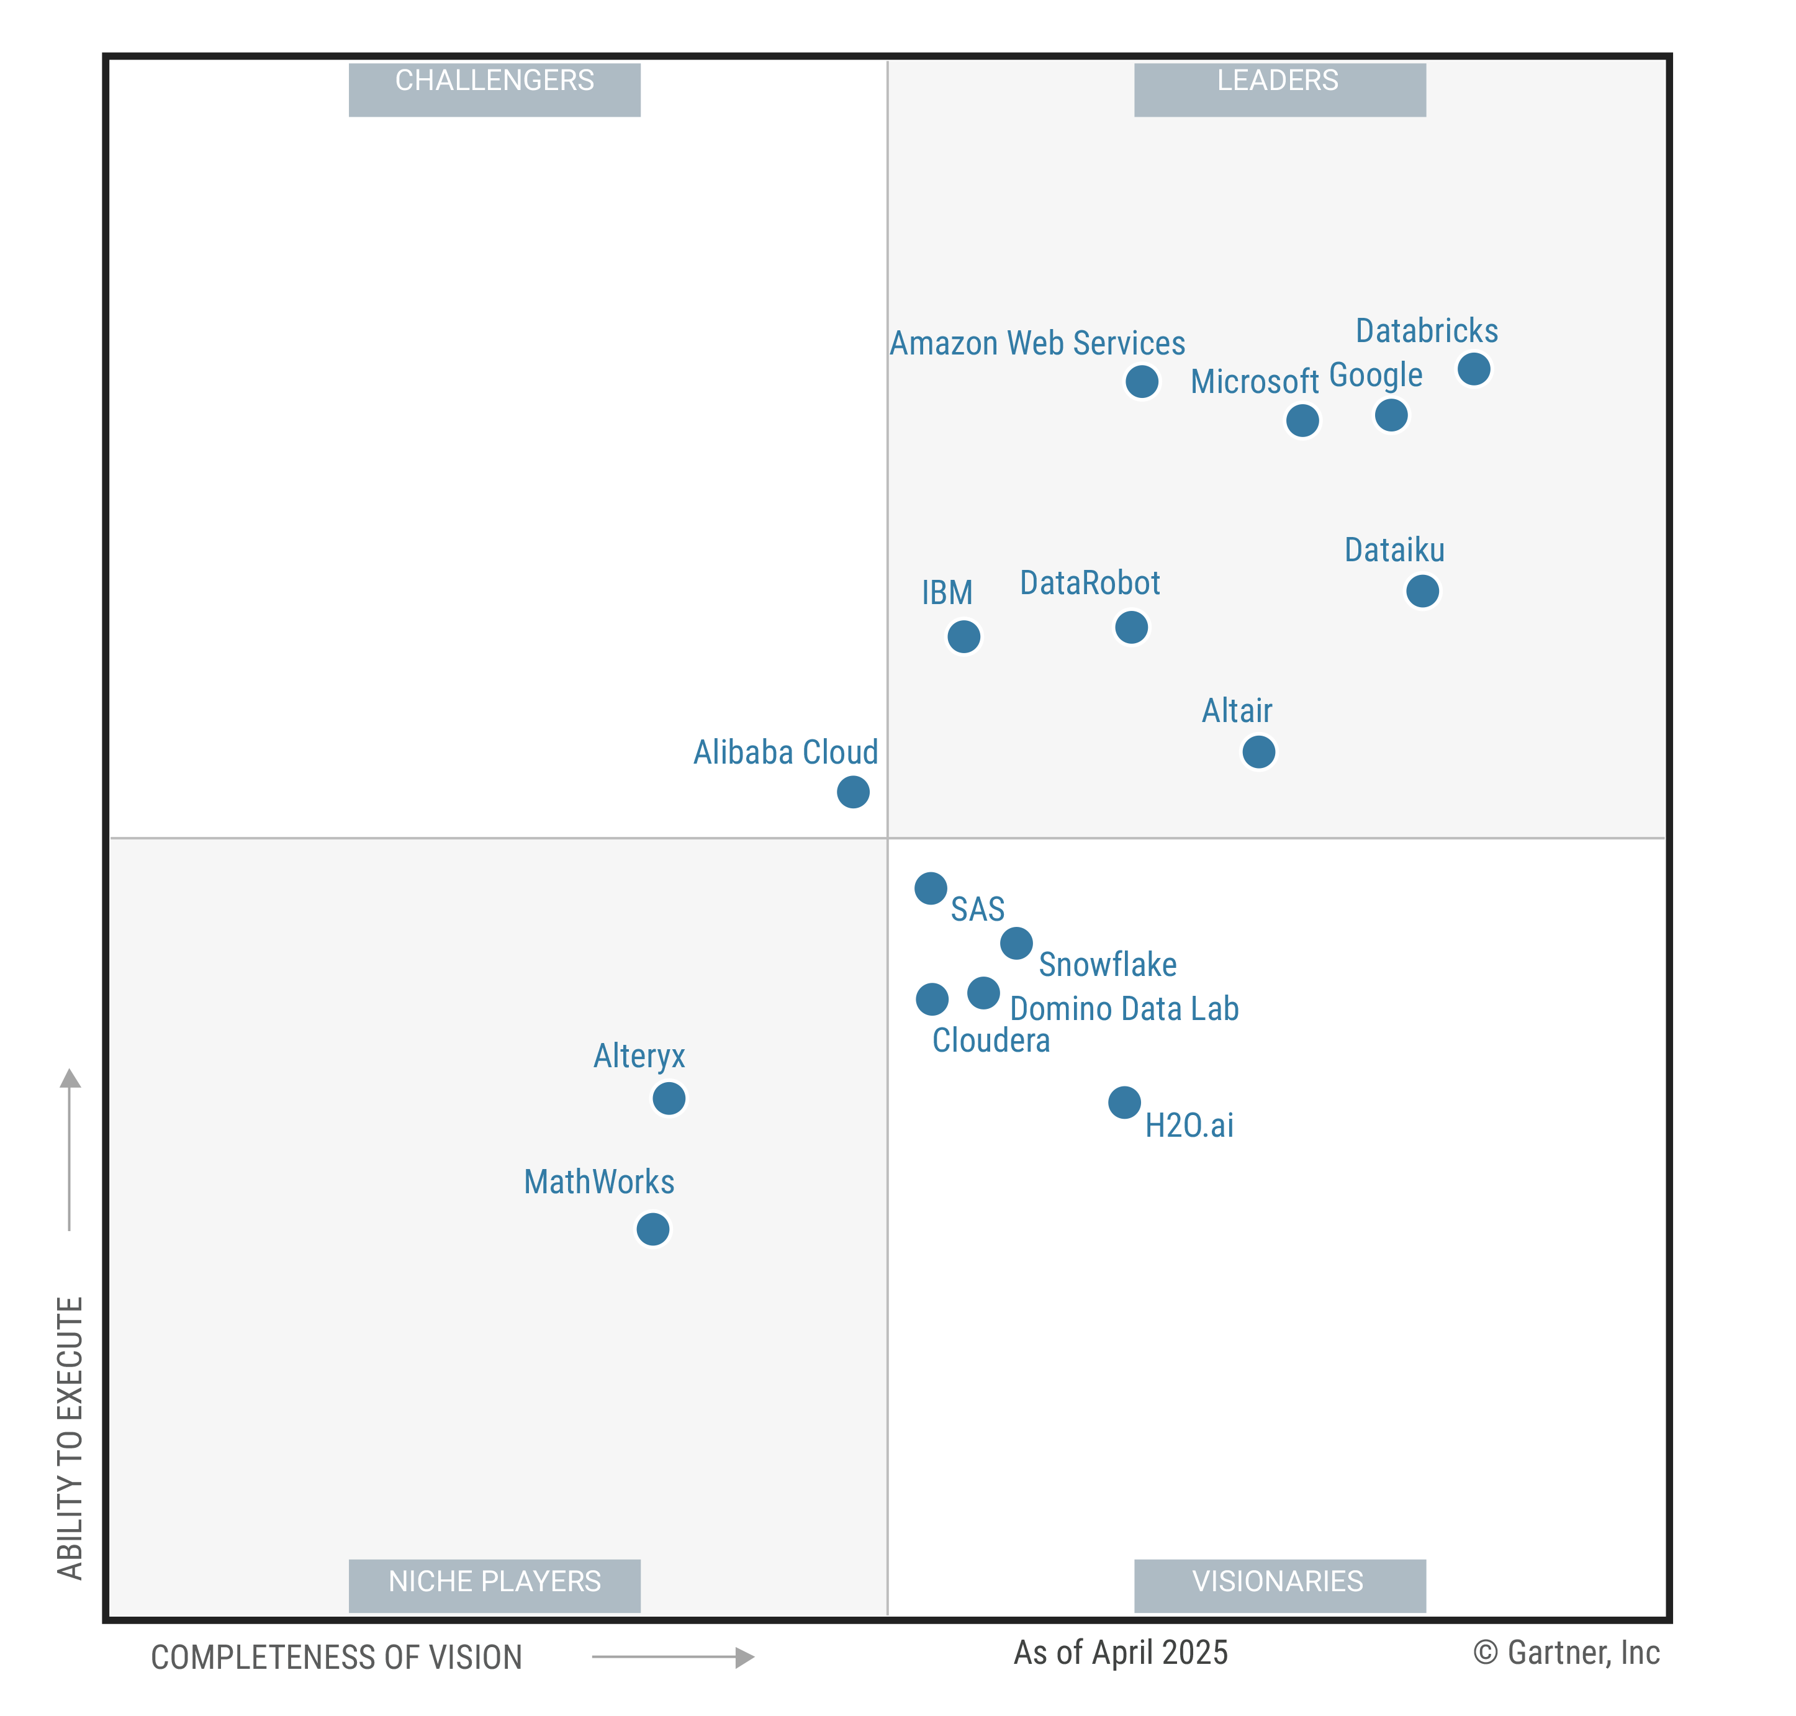

Tools: Commercial Players
2025 Gartner MQ Data Science and Machine Learning.
Only covers companies, not open-source tools like Python and R.

Slide 50

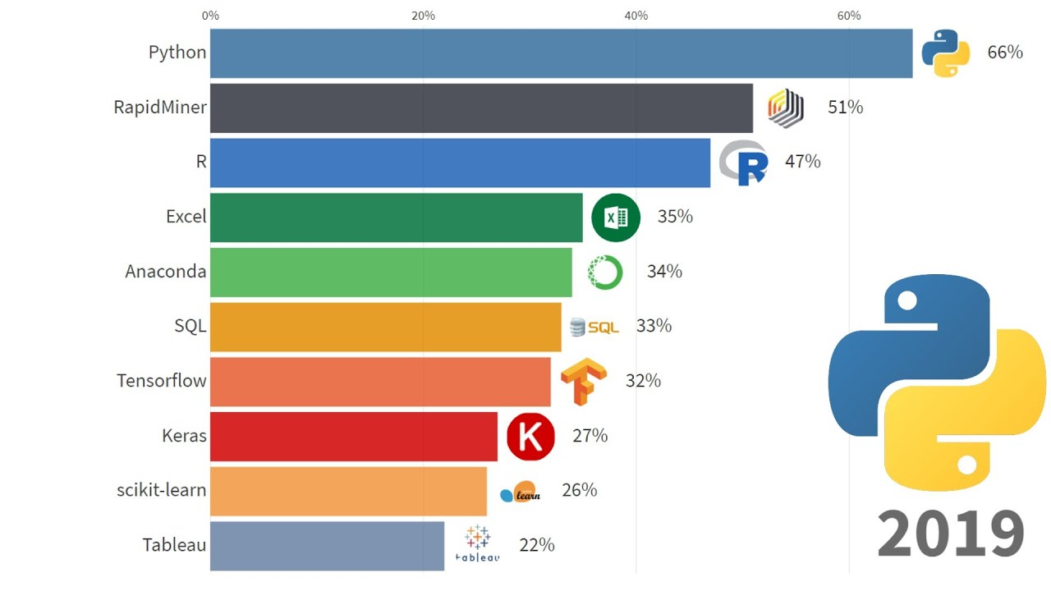
Tools: Popularity – Data Science Tools Popularity Poll
https://www.kdnuggets.com/polls/
Question: What tools do you use? (multiple answers possible) N = 1800

Slide 51
Tools: Types
Simple graphical user interface
Process oriented
Programming oriented

Slide 52
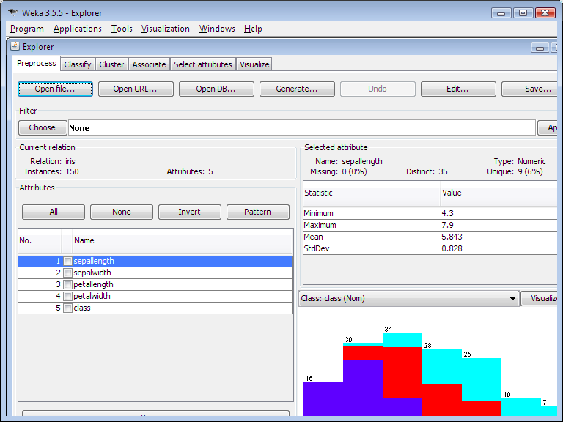
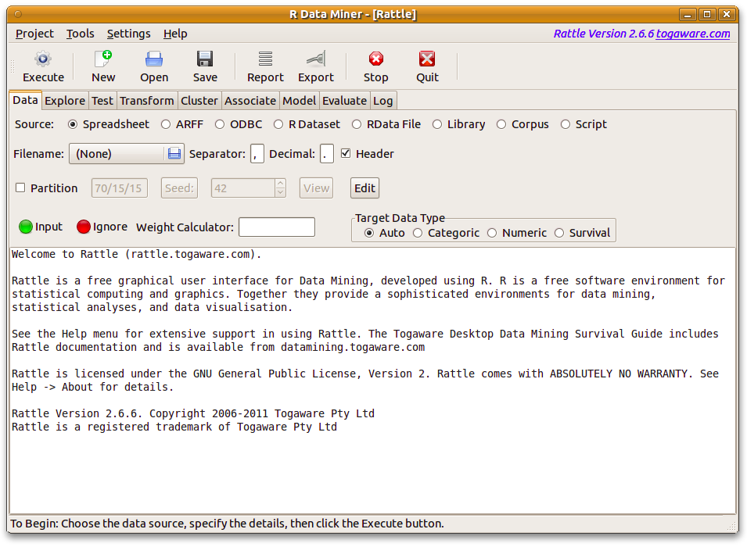
Tools: Simple GUI
Weka: Waikato Environment for Knowledge Analysis (also has a Java API)
Rattle: GUI for Data Mining using R

Slide 53
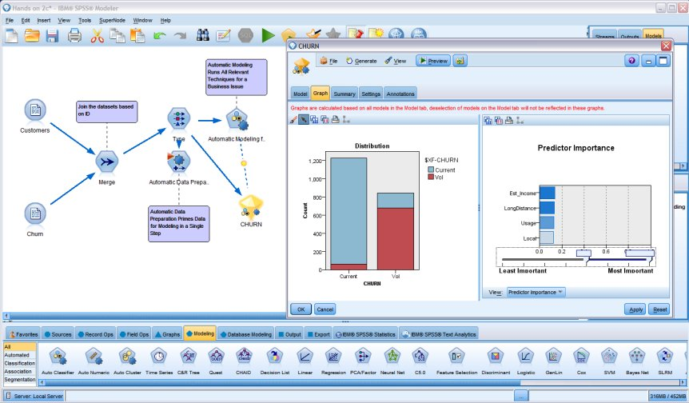
Tools: Process oriented
SAS Enterprise Miner
IBM SPSS Modeler
RapidMiner
Knime
Orange

Slide 54




Tools: Programming oriented
R
Rattle for beginners
RStudio IDE, R markdown, shiny
Python
Numpy, scikit-learn, pandas
Jupyter notebook
→ Both have similar capabilities but slightly different focus:
R: statistical computing and visualization, data mining
Python: Scripting, big data, deep learning, ML
Interoperability via rpy2 and reticulate

Slide 55
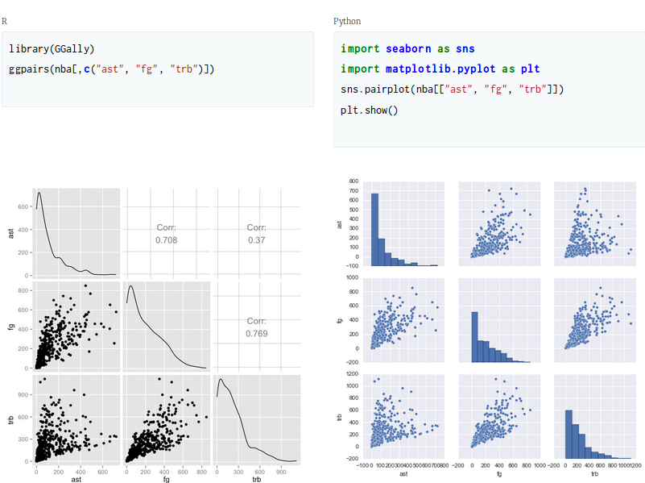
https://www.dataquest.io/blog/python-vs-r/

Slide 56
Agenda
What is Data Mining?
Data Mining Tasks
Relationship to Statistics, Optimization, Machine Learning and AI
Tools
Data
Legal, Privacy and Security Issues

Slide 57
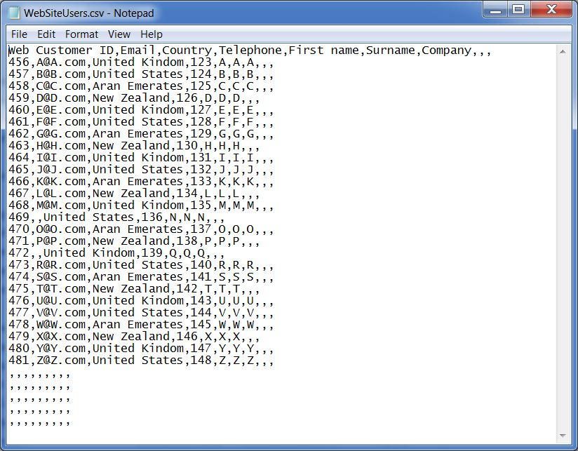
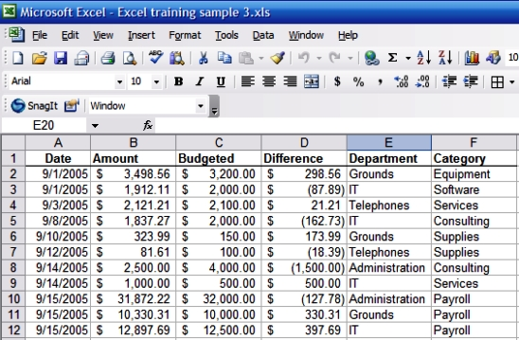
Data
Table in a relation database
Comma Separated Values format

Slide 58
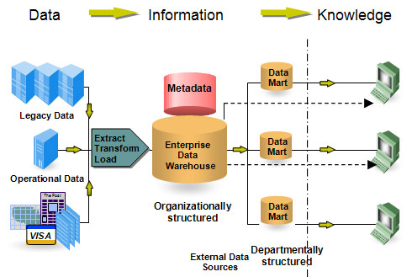
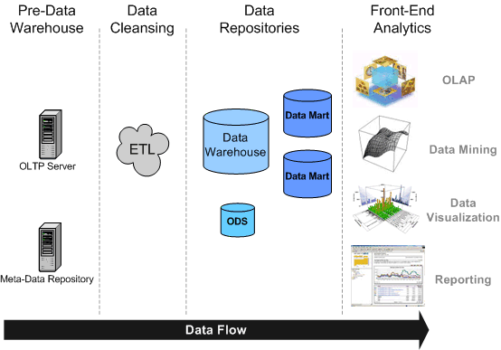
Data Warehouse
http://www.fulcrumlogic.com/data_warehousing.shtml

Slide 59
Data Warehouse
Subject Oriented: Data warehouses are designed to help you analyze data (e.g., sales data is organized by product and customer).
Integrated: Integrates data from disparate sources into a consistent format.
Nonvolatile: Data in the data warehouse are never overwritten or deleted.
Time Variant: maintains both historical and (nearly) current data.

Slide 60
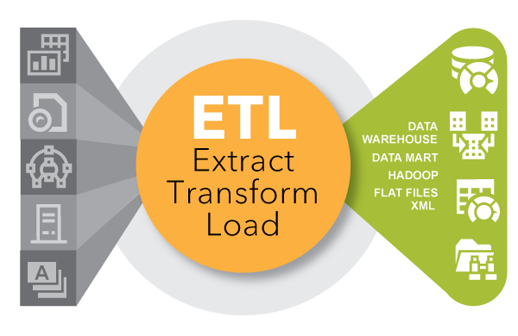
ETL: Extract, Transform and Load
Extracting data from outside sources
Transforming data to fit analytical needs. E.g.,
Clean missing data, wrong data, etc.
Normalize and translate (e.g., 1 → "female")
Join from several sources
Calculate and aggregate data
Loading data into the data warehouse
Source: SAS, ETL: What it is and why it matters

Slide 61
OnLine Analytical Processing (OLAP)
Operations:
Slice
Dice
Drill-down
Roll-up
Pivot
Smart phones
Product
2012
Time
TX
Region
Store data in "data cubes" for fast OLAP operations.
Requires a special database structure (Snow-flake scheme).

Slide 62
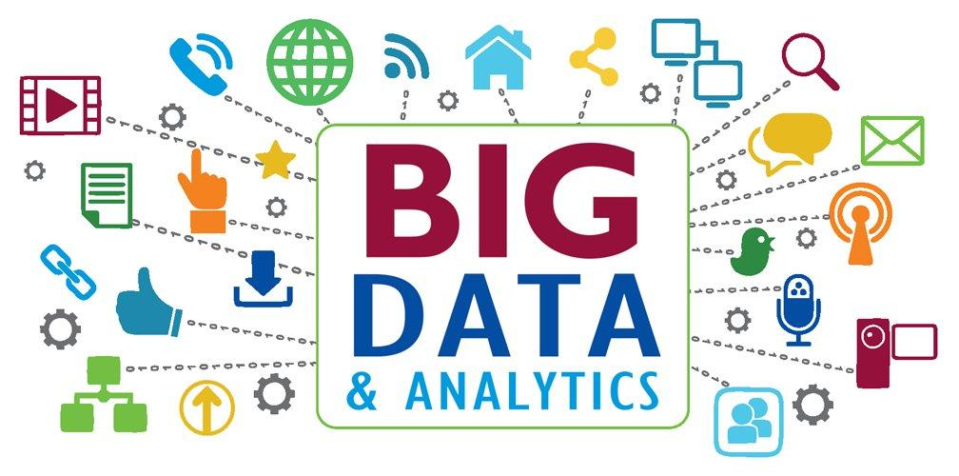

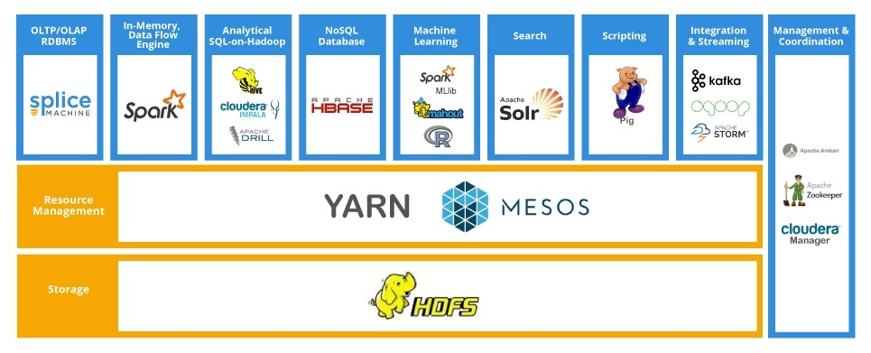
Big Data
"Big data is a term for data sets that are so large or complex that traditional data processing applications are inadequate to deal with them." Wikipedia
3 V's: Volume, velocity, variety, (veracity) Gartner
Computation
MapReduce
Distributed
Computation
Distributed

Slide 63
Agenda
What is Data Mining?
Data Mining Tasks
Relationship to Statistics, Optimization, Machine Learning and AI
Tools
Data
Ethics, Privacy and Security Issues

Slide 64
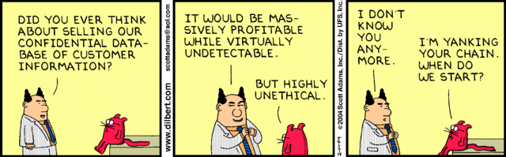
Legal, Privacy and Security Issues
?

Slide 65
Legal, Privacy and Security Issues
Are we allowed to collect the data?
Some data is protected by law (health, educational)
Are we allowed to use the data?
Laws, copyright, etc.
Is privacy preserved in the process?
Anonymize data by removing personally identifiable data.
Is it ethical to use and act on the data?
Will someone get hurt?
Problem: Internet is global, but legislation is local!

Slide 66


Ethics, Privacy and Security Issues
Data-Gathering via Apps Presents a Gray Legal Area By KEVIN J. O’BRIEN Published: October 28, 2012
BERLIN — Angry Birds, the top-selling paid mobile app for the iPhone in the United States and Europe, has been downloaded more than a billion times by devoted game players around the world, who often spend hours slinging squawking fowl at groups of egg-stealing pigs.
When Jason Hong, an associate professor at the Human-Computer Interaction Institute at Carnegie Mellon University, surveyed 40 users, all but two were unaware that the game was storing their locations so that they could later be the targets of ads....

Slide 67


Slide 68

Here is what the small print says...
USA Today Network Josh Hafner, 2:38 p.m. EDT July 13, 2016
Pokémon Go’s constant location tracking and camera access required for gameplay, paired with its skyrocketing popularity, could provide data like no app before it.
“Their privacy policy is vague,” Hong said. “I’d say deliberately vague, because of the lack of clarity on the business model.”
...
The agreement says Pokémon Go collects data about its users as a “business asset.” This includes data used to personally identify players such as email addresses and other information pulled from Google and Facebook accounts players use to sign up for the game.
If Niantic is ever sold, the agreement states, all that data can go to another company.

Slide 69
Conclusion
Data Mining is interdisciplinary and overlaps significantly with many fields
Statistics
CS (machine learning, AI, data bases)
Optimization (Operations Research)
Data Mining requires a team effort with members who have expertise in several areas
Data management
Statistics
Programming
Communication
+ Application domain
(Business) Analytics
Data Science

